Slide 1
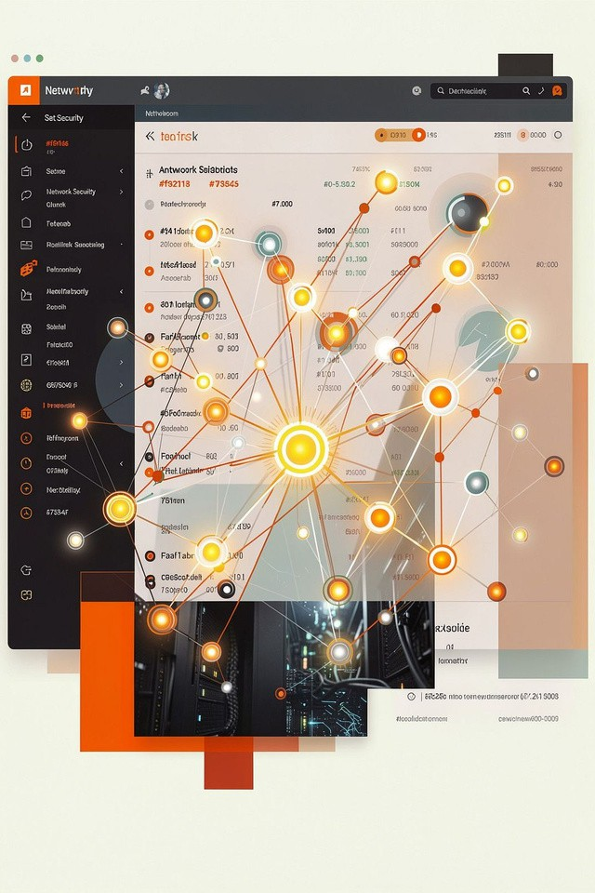
Threat Intelligence Kill-Chain Correlation Engine
A Java and DSA Based Cybersecurity Threat Analysis System
Student 1
Name: Samyuktha Kandukuri
Roll Number: 2520090157
Student 2
Name:K.Usha Rani
Roll Number:2520090049

Slide 2
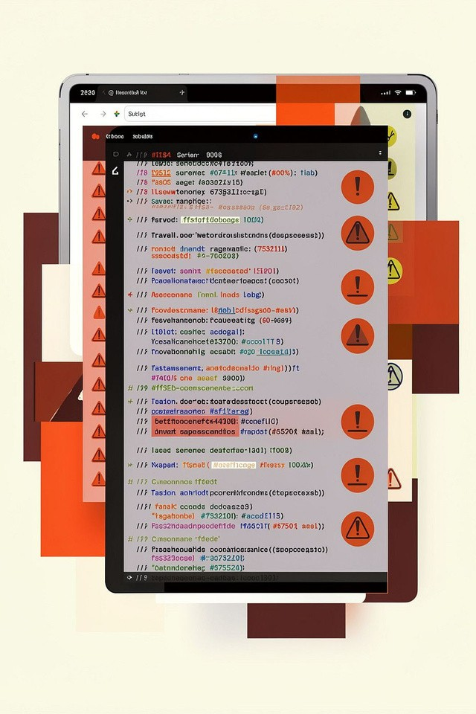
Abstract
Organisationsgeneratelarge volumes of security logs from endpoints, servers, firewalls and network devices. Manual review is slow and error-prone. This project implements a Java-based system using core data structures and algorithms to parse logs, detect suspicious events, correlate related alerts, reconstruct multi-step attack sequences (kill chains), and recommend key monitoring points. Practical DSA used
includes ArrayList, HashMap, Queue, Stack and Graph structures with searching and traversal algorithms.

Slide 3
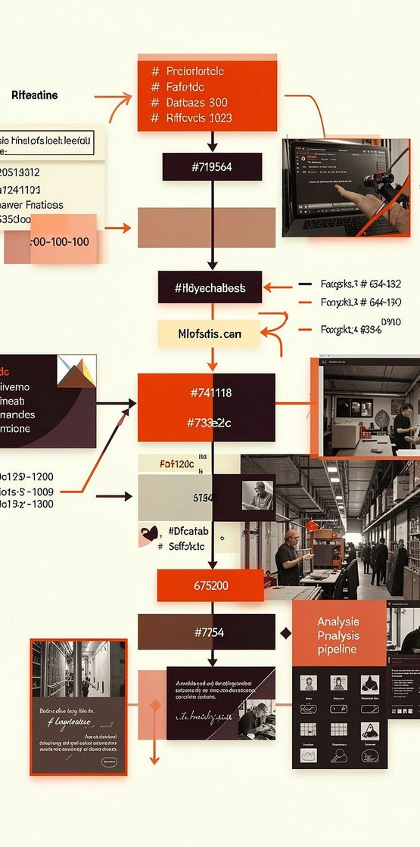

Introduction
Cybersecuritylogs:timestampedrecords of events (logins, connections, errors).
  Threat intelligence: evidence and context used to detect and prioritise threats.
  Need for analysis: raw logs are noisy; patterns spanning many events reveal attacks.
  Security alert: a flagged event requiring attention (single or correlated).
  Kill chain: ordered steps an attacker takes from initial access to objective.
  Correlation importance: linking alerts reveals multi-step attacks and critical paths.
Security Logs
Timestamped raw event records
Alert Correlation
Link related alerts into incidents
Threat Detection
Identifysuspicious patterns
Security Analysis
Contextualizeand prioritize threats
Flow: Security Logs → Threat Detection → Alert Correlation → Kill Chain → Attack Graph → Security Analysis

Slide 4
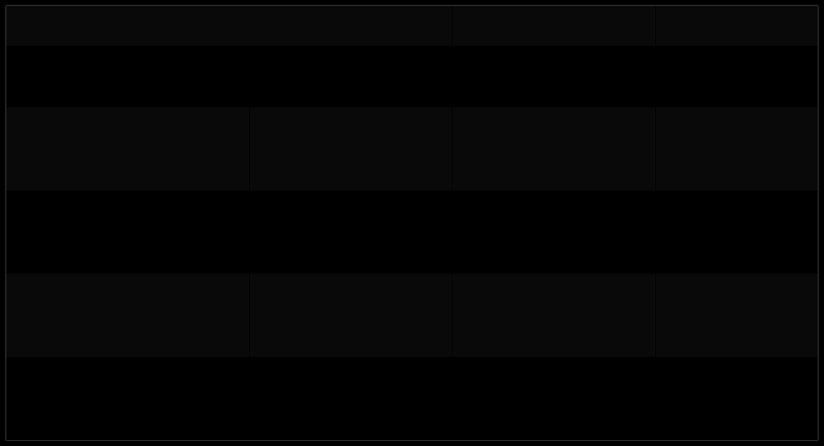
Literature Survey
Existing Approach
Main Idea
Limitation
Relevance
Security log analysis tools
Parse and summarise raw logs
Scale and contextual correlation are limited
Basis for parsing and normalization
Intrusion Detection Systems (IDS)
Signature / anomaly detection of malicious activity
Many false positives; limited multi-step view
Informs detection
rules and signatures
SIEM + alert correlation
Aggregate alerts and correlate events
Complex configuration; expensive
Inspires event correlation component
Kill-chain analysis
Model attacker progression across stages
Often high-level; reconstruction from logs is hard
Framework for ordered attack reconstruction
Graph-based analysis
Represent systems and paths as nodes/edges
Needs efficient traversal for large graphs
Directly maps to our DSA-based attack
graph

Slide 5

Problem Statement &
Objectives
Huge volume of security logs across devices.
Problem Statement
Manual analysis is time-consuming and error-prone.
Single alerts often miss the full multi-step attack.
Reconstructing attack sequences from disparate logs is difficult.
Identifying critical attack paths and efficient monitoring points is challenging.
Objectives
Analyze security logs using Java.
Detect suspicious activities with predefined rules.
Correlate related alerts into coherent incidents.
Reconstruct attack kill chains from correlated alerts.
Represent attack paths using graph structures.
Identify critical choke points in the attack graph.
Recommend effective monitoring points.
Apply DSA concepts (ArrayList, HashMap, Graph, BFS/DFS) to analysis.

Slide 6

Hardware & Software Requirements
Hardware Requirements
Computer / Laptop Minimum 4 GB RAM Intel i3 or equivalent
Minimum 10 GB free storage Internet connection (optional)
Software Requirements
Core Technologies: Java + DSA + Java Servlets + JSP + MySQL Java JDK (latest stable)
Apache Tomcat (web container) MySQL (database)
Eclipse / IntelliJ IDEA / NetBeans
HTML, CSS, JavaScript (for front-end dashboard) Git / GitHub (optional)
Core Technologies emphasised: Java + DSA + Java Servlets + JSP
+ MySQL

Slide 7


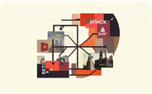

Results — System Behaviour (Example)
Examplelog sequence:
Login Failed → Login Failed → Login Success → Privilege Escalation → Database Access
Detected Threat
Brute-force /
suspicious login pattern
Severity
High — repeated failures followed by success
Correlated Alerts
Multiple login
events linked by source IP/user
Outcome
Attack kill chain reconstructed; choke point identified;
monitoring recommended

Slide 8
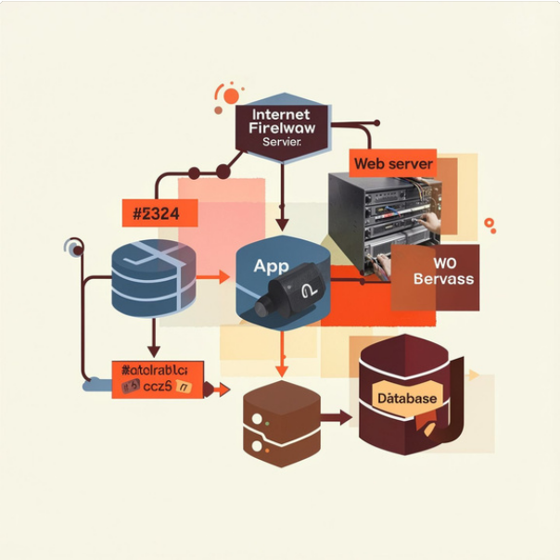
DSA Implementation and Visual Results
Data Structures & Algorithms Used
ArrayList — store parsed log records in order HashMap — group logs by IP / user for quick lookup Queue — chronological event processing (FIFO)
Stack — track active attack path while reconstructing sequences
Graph — nodes = systems; edges = observed interactions
BFS / DFS — traverse attack graph to find paths and reachability
Searching — detect predefined signatures/patterns in logs
Graph analysis — identify high-degree or articulation nodes as choke points
Example choke point: Application Server — single point that, if monitored, reveals lateral movement to Database.

Slide 9
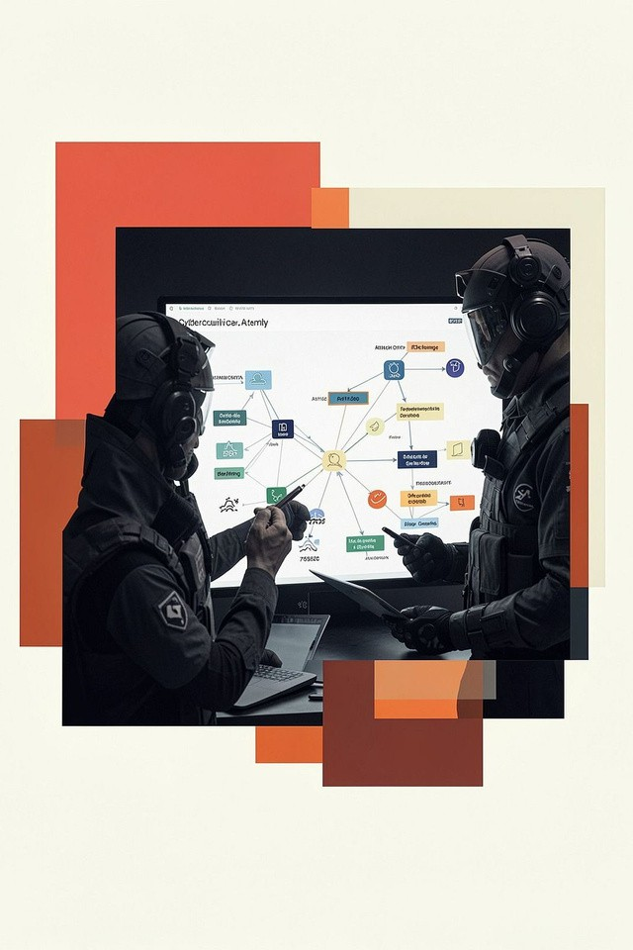
Conclusion
TheThreat Intelligence Kill-Chain Correlation Engine demonstrates a structured, DSA-driven approach to turning noisy security logs into meaningful threat intelligence. Implemented in Java, the system parses logs, detects suspicious events, correlates alerts into incidents, reconstructs kill chains, and models attack paths as graphs to identify critical choke points and efficient monitoring locations. The project is suitable for academic evaluation and practical extension.

Slide 10

Future Scope
Real-time monitoring Stream logs and
correlate alerts as events occur.
IDS/IPS integration
Ingest alerts directly from intrusion detection/prevention systems.
SIEM platform integration Forward correlated
incidents to enterprise SIEMs.
Advanced graph algorithms
Use centrality, shortest-
path and community detection to prioritise
nodes.
Large datasets & cloud monitoring
Scale with distributed storage and
cloud log sources.
ML for anomaly detection (Future)
Investigate machine-learning
models for anomaly scoring (not implemented now).
Automated responses
Trigger containment actions for
high-severity correlated incidents.
Future work focuses on scalability, real-time operation and safe, tested automation. Machine learning is listed as a prospective enhancement only.

Slide 11
THANK YOU

